Slide 1

FPGA basic Structure and Concept of synthesis
باسمه تعالی
احسان یزدیان
بهمن 1403

Slide 2
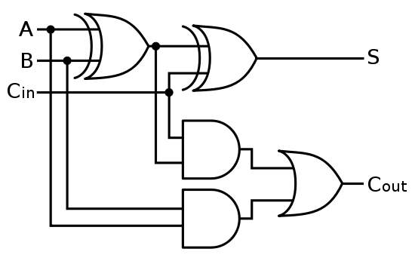
Concept of Synthesis
FPGA has Large Number of Logic Block ‘Islands’ in a ‘Sea’ of Interconnects
Example: Designing a Full Adder
We can implement this design in FPGA using FPGA programming softwares.
We can put these blocks together to design multi-bit adders.
Real projects are much more complex than this simple adder.
Full Adder

Slide 3
Hardware Design Languages (Verilog)
Behavioural codes instead of gate level design.
Verilog, VHDL, ....
Example of verilog code for adder:
module fulladder(
input a,
input b,
input c_in,
output out,
output c_out
);
assign {c_out,out}=a+b+c_in;
endmodule
Synthesis tools convert behavioural codes to gates which can be implemented on FPGA.
Observing the output of the synthesize tool in Xilinx ISE.

Slide 4
Hardware Design Languages (Verilog)
Example: Behavioural Verilog code for Counter:
module counter(
input clk,
input reset,
output reg [20:0] counter);
always @(posedge clk)
if (reset)
counter<=0;
else
counter<=counter+1;
endmodule
Observing the output of the synthesize tool in Xilinx ISE.
Observing Sequential and Combinational structures.

Slide 5
Hardware Design Languages
There are two popular industry standard hardware description languages:
VHDL
Verilog
There exists many specific tools and libraries written in either VHDL or Verilog.
VHDL (Very high speed integrated circuit Hardware Description Language) became IEEE standard 1076 in 1987.
The Verilog language has been used far longer than VHDL and became IEEE Standard 1364-1995 (Verilog-95)
it was launched by Gateway company in 1983.
Cadence bought Gateway and opened Verilog to the public domain in 1990.
Extensions to Verilog-95: IEEE Standard 1364-2001 known as Verilog-2001 (support for 2's complement signed variables and ….).
A New Trend in Hardware Description:
High-level synthesis(HLS): Accept synthesizable subsets of ANSI C/C++/SystemC/MATLAB. Then the code is analysed to create a register-transfer level (RTL) code such as Verilog and VHDL.
New Trend

Slide 6
Popularity of Verilog HDL
Verilog HDL
General-purpose
Easy to learn, easy to use
Similar in syntax to C
Supported by logic synthesis tools and simulators.
Not all constructs are synthesizable
Example of non synthesizable Command
module useless;
initial begin
$display(“Hello World!”);
#10 $finish;
end
endmodule
Compare to printf() in C

Slide 7
ماژول Module
Verilog Basic Building Block
It can communicate with other parts of the project through ports:
Input ports
Output ports
Bidirectional ports
These ports may be real FPGA I/Os or wires inside the design
A module can be defined without any ports.
Ports can be multiple bits wide.
Example: input [7:0] a;
Module
1
Module
2
Module
3

Slide 8
Module:definition
Definition of a module
module <module_name> (<module_port_list>);
<ports definition>
<variables definition>
...
<module functionality>
...
endmodule
A Simple Example:
module halfadd (c,s,a,b);
input a,b;
output s,c;
xor xor_inst (s,a,b) ;
and and_inst (c,a,b) ;
endmodule

Slide 9
Module Ports Declaration
Interface of the module to the environment
Internals of the module are not visible to the environment
Items to define
Port list
Port type: input, output, inout
Port details (reg or wire, and bit-width)
Example
module example(sum, c_out, a,b,c_in);
output reg [3:0]sum;
output reg c_out;
input [3:0] a, b; //wire by default
input c_in; //wire by default
...
<module internals>
...
endmodule

Slide 10
ANSI C Style Port Declaration Syntax
An easier way to define the ports:
In Verilog‐2001 the port list can directly follow the module declaration
module example(
output [3:0] sum,
output c_out,
input [3:0] a, b, //wire by default
input c_in); //wire by default
...
<module internals>
...
endmodule
Compare it to the traditional style

Slide 11
Module Hierarchy and Module Instantiation
Modules can be used within other modules.
Module instantiation: employing a module within another module: sub-module.
This permits hierarchical design and the re-use of modules.
Example: creating a Full Adder
Main Module
Module 2
Module
3
Module
4
module fulladd(c_out, sum, a, b, c_in); //main module
input a, b, c_in;
output c_out, sum;
wire w1, w2, w3;
halfadd M1 (w1, w2, a, b ); //sub-module
halfadd M2 (w3, sum, w2, c_in ); //sub-module
or M3 (c_out, w3, w1 ); // primitive instantiation
endmodule

Slide 12
Module Instantiation
Illegal instantiation example:
Nested module definition not allowed
Note the difference between module definition and module instantiation
Example
module top_module(q, clk, reset);
output [3:0] q;
input clk, reset;
module sub_module(q, clock, reset);
:
<module T_FF internals>
:
endmodule// END OF ILLEGAL MODULE NESTING
endmodule
ILLEGAL MODULE NESTING

Slide 13
Lexical Conventions (قواعد نوشتاری)
Verilog HDL is a case-sensitive language.
All keywords are in lowercase.
Names of variables are similar to C in many ways:
All keywords are lowercase
Names can use a…z, A…­Z, 0…­9
Names don't start with 0­…9
Comments
Comments can be inserted in the code for readability and documentation.
One-line comments start with "//".
Multiple-line comment starts with "/*" and ends with "*/".
Examples
a = b && c; // This is a one-line comment
/* This is a multiple line
comment */
/* This is /* an illegal */ comment */

Slide 14
Data Values
For our logic design purposes, we’ll consider Verilog to have four different bit values:
0 - Logical 0 or FALSE
1 - Logical 1 or TRUE
x, X - Unknown logic value
z, Z - High impedance condition
Number Representation
a=6'b0101001; b=4'd14; c=4'hA;
Format: <size><base_format><number>
<size> - decimal specification of number of bits (optional)
<base format> - ' followed by arithmetic base of number (optional)
<d> <D> - decimal – (default base)
<h> <H> - hexadecimal
<o> <O> - octal
<b> <B> - binary
<number> - value given in the specified base

Slide 15
Number Representation
Underscore characters “_” can is used for reading clarity and is ignored by Verilog.
If first character of sized, binary number is
0, 1, the value is 0-filled up to size.
x or z,value is extended using x or z, respectively.
Examples:
6'b010_111 gives 010111
8'b0110 gives 00000110
8'b1110 gives 00001110
4'bx01 gives xx01
16'H3AB gives 0000_0011_1010_1011
5'O36 gives 11110
16'Hx gives xxxxxxxxxxxxxxxx
23456 // This is a 32-bit decimal number by default
'hc3 // This is a 32-bit hexadecimal number
Negative numbers
Put the sign before the <size>
Examples:
-6’d3
4’d-2// illegal
Two’s complement is used to store the value (the result of subtracting the number from 2^{N})

Slide 16
Levels of Abstraction in Verilog
سطوح مختلف توصیف سخت افزار
سطح توصیف رفتاری :Behavioral (algorithmic) level
Describe the algorithm used
Similar to C programming
سطح انتقال داده: Dataflow level
Flow of data in the design
سطح گیت: Gate level
Interconnect logic gates
سطح ترانزیستور: Switch level
Interconnect transistors (MOS transistors)
For design with FPGA devices, transistor level modeling is not appropriate.
RTL Coding: Register-Transfer Level
Describing a digital circuit in terms of the flow of digital signals (data) between hardware registers, and the logical operations performed on those signals.

Slide 17
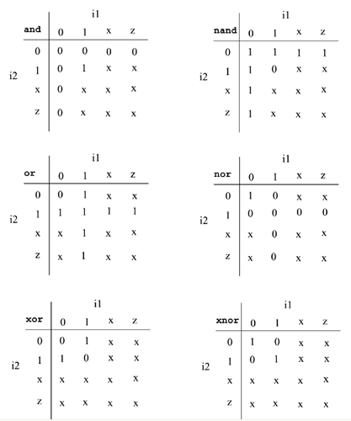
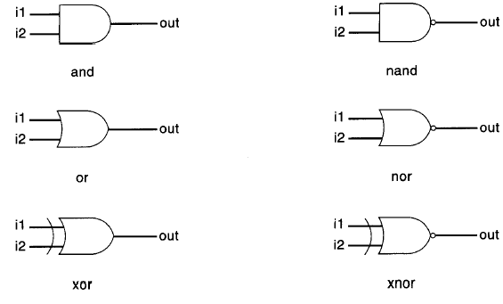
Gate Level Modeling
Similar to module instantiations
Examples
wire out1, out2, out3, out4, in1, in2, in3;
and a1 (out1, in1, in2);
nand nand1 (out2, in1, in2);
nand nand2 (out3, in1, in2, in3);
and (out4, in1, in2);
// No need to instance name.

Slide 18
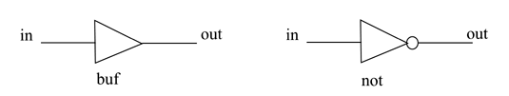
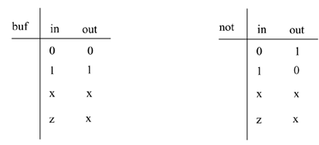
Buffers and Not Gates
Simple Example
buf b1(OUT1, IN);
not n1(OUT1, IN);
May have more than two outputs
buf b1_2out(OUT1, OUT2, IN);

Slide 19
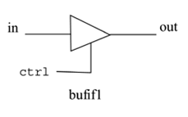
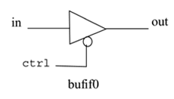
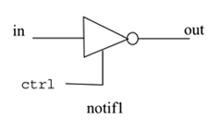
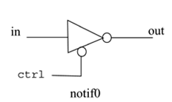
Bufif/Notif Gates
ctrl
z | x | 1 | 0 | bufif1 | in
x | x | 0 | z | 0
x | x | 1 | z | 1
x | x | x | z | X
x | x | x | z | Z
ctrl
z | x | 1 | 0 | notif1 | in
x | x | 1 | z | 0
x | x | 0 | z | 1
x | x | x | z | X
x | x | x | z | Z
Applicable when multiple drivers drive the signal.
Examples
bufif1 b1 (out1, in, ctrl);
bufif0 b0 (out2, in, ctrl);
//Instantiation of notif gates
notif1 n1 (out3, in, ctrl);
notif0 n0 (out4, in, ctrl);

Slide 20
Arrays of Gate Instances
Multiple instantiations
wire [7:0] OUT, IN1, IN2;
nand n0(OUT[0], IN1[0],IN2[0]);
nand n1(OUT[1], IN1[1],IN2[1]);
nand n2(OUT[2], IN1[2],IN2[2]);
nand n3(OUT[3], IN1[3],IN2[3]);
nand n4(OUT[4], IN1[4],IN2[4]);
nand n5(OUT[5], IN1[5],IN2[5]);
nand n6(OUT[6], IN1[6],IN2[6]);
nand n7(OUT[7], IN1[7],IN2[7]);
Array of instances
wire [7:0] OUT, IN1, IN2;
nand n[7:0](OUT, IN1, IN2);

Slide 21
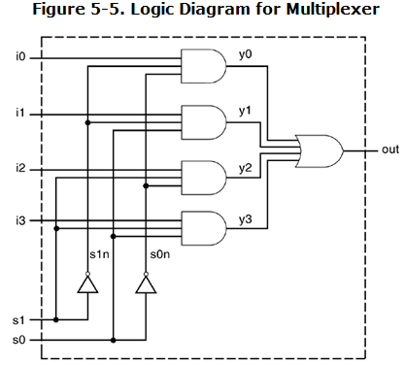
Example
module mux4_to_1 (output out, input i0, i1, i2, i3, s1, s0);
wire s1n, s0n;
wire y0, y1, y2, y3;
not (s1n, s1);
not (s0n, s0);
and (y0, i0, s1n, s0n);
and (y1, i1, s1n, s0);
and (y2, i2, s1, s0n);
and (y3, i3, s1, s0);
or (out, y0, y1, y2, y3);
endmodule

Slide 22
Data Types In Verilog
There are two main data types in Verilog.
Nets.
Used for structural connectivity
Similar to real wires
Registers.
Abstraction of storage (May or may not be real physical storage)
Properties of Both
Informally called signals
May be either scalar (one bit) or vector (multiple bits)

Slide 23
Net Data Type
wire
Most important net type.
connectivity only; no logical
Wires are “continuously assigned” values and do not “remember”, or store, information.
This behaves much like an electrical wire...
Default Value: z
Example
Full adder syntax:
wire w1, w2, w3;
Add_half M1 ( w1, w2, a, b );
Add_half M2 ( sum, w3, w1, c_in ); // child module
or ( c_out, w2, w3 ); // primitive instantiation
wire gnd_wire = 1’b0;
Vector of wire: wire [msb_index : lsb_index] data_id;
Example:
wire [7:0] bus;
wire [31:0] busA, busB, busC;
wire [0:7] flag;

Slide 24
Register Data Types
Registers are “behaviorally assigned” values and “remember”, or store, information until the next value assignment is made.
The name “reg” does not mean it must be implemented as a physical register! But it could be!
Default value: x
Examples
reg a, b, c=0;
reg reset;
initial // this construct will be discussed later
begin
reset = 1'b1; //initialize reset to 1 to reset the digital circuit.
#100 reset = 1'b0; // after 100 time units reset is deasserted.
end
Vector of register: Exampel reg [7:0] a;
reg/wire vectors are unsigned numbers, unless specified
Signed Register Declaration
reg signed [63:0] m; // 64 bit signed value, 2’s complemenmt

Slide 25
Other Register Data Types: integer, real
Integer (32 bit register, Default value: 0)
integer p,m,n;
Bit width: implementation-dependent (at least 32-bits)
Designer can also specify a width: integer [7:0] tmp;
Very similar to a vector of reg
integer variables are signed numbers
reg signed [31:0] n=0; // 32 bit signed value
Real (Default value: 0)
Decimal notation: 12.24 Scientific notation: 3e6(=3*10^6)
When a real value is assigned to an integer, the real number is rounded off to the nearest integer.
Example: real delta;
integer i;
initial delta=4e10;
initial delta=2.13;
initial i = delta; // i gets the value 2

Slide 26
Register Data Types: Time (will be seen in examples)
Used to store values of simulation time
Keyword: time
Bit width: implementation-dependent (at least 64)
$time system function gives current simulation time
Example:
time save_sim_time;
initial
save_sim_time = $time;

Slide 27
Variable Vector Part Select
Using a variable part select, one can choose parts
reg[255:0] data1;
reg[0:255] data2;
reg[7:0] byte;
byte = data1[31-:8]; // => data1[31:24]
byte = data1[24+:8]; // => data1[31:24]
byte = data2[31-:8]; // => data2[24:31]
byte = data2[24+:8]; // => data2[24:31]
The starting bit can also be a variable. The width has to be constant. Therefore, one can use the variable part select in a loop to select all bytes of the vector.
for (j=0; j<=31; j=j+1)
byte = data1[(j*8)+:8]; //Sequence is [7:0], [15:8]... [255:248]
//Can initialize a part of the vector
data1[(byteNum*8)+:8] = 8'b0; //If byteNum= 1, clear 8 bits [15:8]

Slide 28
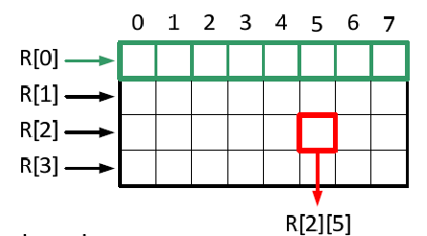
Memories and Multi-dimensional arrays
Allowed for all data types
Multi-dimensional
Syntax:
<data_type> [msb_index : lsb_index] <var_name> [start_idx : end_idx] .... [start_idx: end_idx];
For multi-dimensional arrays, indexes need to be provided for each dimension.
Examples:
reg [0:7] R [3:0];
integer count [0:7];
reg [10:0] port_id [7:0];
reg bool[31:0];
integer matrix[4:0][0:16];
reg [63:0] array_4d [15:0][7:0][7:0][255:0];
wire [7:0] w_array2 [5:0];
initial begin
array_4d[0][0][0][0][15:0] = 0;
array_4d[0][4][3][0] = 0;
port_id= 0; // Illegal
matrix [1] = 0; // Illegal
R [1:2] = 0; // Illegal
end
It is important not to confuse arrays with net or register vectors. A vector is a single element that is n-bits wide. On the other hand, arrays are multiple elements that are 1-bit or n-bits wide.

Slide 29
Parameters
Constants defined in a module
Keyword: parameter.
module DUT (s, Out);
parameter n = 3;
parameter S0 = 4;
input [n‐1:0] s;
output [n:0] Out;
wire [n:0] Out;
assign Out = S0;
endmodule

Slide 30
Module Ports Declaration rules
All ports are wire by default
No need to declare it again as wire
If expected to be reg, the port needs to be declared again
Input ports could not be of type reg.
output ports could be of type reg.
Example: the q port in DFF module
module DFF(q, d, clk, reset);
output q;
reg q; // Output port q holds value => reg
input d, clk, reset;
...
endmodule

Slide 31
Port Mapping rules in Module Instantiation
Connecting by ordered list
More intuitive for beginners.
Mostly used when having few ports.
Connecting by name
Used when having more ports.
Gives independence from the order of ports.
The order of ports in the port list of a module can be changed without changing the instantiations.
module Top;
...
fulladd4 fa_ordered(
SUM, C_OUT,
A, B, C_IN);
...
endmodule
module Top;
...
fulladd4 fa_byname(
.c_out(C_OUT),
.sum(SUM),
.b(B),
.a(A));
...
endmodule

Slide 32
Port Connection Rules
Width matching
Legal to connect items of different sizes
A warning may be issued by Verilog simulator
Unconnected ports
Allowed in Verilog
Example: module fulladd(c_out ,sum, a, b, c_in);
Instants:
fulladd fa1( ,SUM, A, B, C_IN); // port c_out is unconnected
fulladd fa2( .sum(SUM), .a(A), .c_in(1’b0), .b(B));

Slide 33
Examples: 4-bit full adder
module fulladd4(
output [3:0] sum,
output c_out,
input [3:0] a, b,
input c_in);
wire c1, c2, c3;
// Instantiate four 1-bit full adders.
fulladd fa0(c1, sum[0], a[0], b[0], c_in);
fulladd fa1(c2, sum[1], a[1], b[1], c1);
fulladd fa2(.c_out(c3), .sum(sum[2]),.a(a[2]),.b(b[2]), .c_in(c2));
fulladd fa3(.c_out(c_out),.sum(sum[3]),.a(a[3]),.b(b[3]), .c_in(c3));
endmodule

Slide 34
Hierarchical Names
fulladd4
fa1
fulladd
......
fa4
fulladd
sum, c_out,
a, b, c_in
M1
halfadd
M2
halfadd
a, b, c_in, w1, w2, w3, …
M1, M2
Hierarchical names
fulladd4 fulladd4.sum fulladd4.fa4.b
fulladd4.fa1 fulladd4.fa1.c_in fulladd4.fa1.M1

Slide 35
Test and Verification
Testbench Module
Design Under Test (DUT)
Stimulus Generation
Checking Outputs of DUT

Slide 36
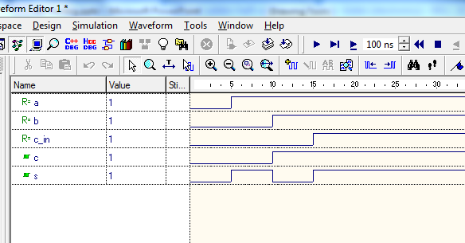
Testbench for FullAdder
Testbech
`timescale 1ns/1ps
module testbench;
reg a,b,c_in;
wire c,s;
fulladd fulladd_inst(c,s,a,b,c_in);
initial begin
a=0;
b=0;
c_in=0;
#5 a=1;
#5 b=1;
#5 c_in =1;
end
endmodule
module fulladd ( c_out,sum, a, b, c_in ); input a, b, c_in;
output c_out, sum;
wire w1, w2, w3;
halfadd M1 ( w1, w2, a, b );
halfadd M2 ( w3, sum, w2, c_in );
or M3( c_out, w3, w1 );
endmodule

Slide 37
Testbench for mux4_to_1
`timescale 1ns/1ps
module stimulus;
reg IN0, IN1, IN2, IN3;
reg S1, S0;
wire OUTPUT;
mux4_to_1 mymux(OUTPUT, IN0, IN1, IN2, IN3, S1, S0);
initial begin
IN0 = 1; IN1 = 0; IN2 = 1; IN3 = 0;
#10 $display("IN0= %b, IN1= %b, IN2= %b, IN3=%b\n",IN0,IN1,IN2,IN3);
S1 = 0; S0 = 0;
#10 $display("S1 = %b, S0 = %b, OUTPUT = %b \n", S1, S0, OUTPUT);
S1 = 0; S0 = 1;
#10 $display("S1 = %b, S0 = %b, OUTPUT = %b \n", S1, S0, OUTPUT);
S1 = 1; S0 = 0;
#10 $display("S1 = %b, S0 = %b, OUTPUT = %b \n", S1, S0, OUTPUT);
S1 = 1; S0 = 1;
#10 $display("S1 = %b, S0 = %b, OUTPUT = %b \n", S1, S0, OUTPUT);
end
endmodule

Slide 38
Design process (1)
Library IEEE;
use ieee.std_logic_1164.all;
use ieee.std_logic_unsigned.all;
entity RC5_core is
port(
clock, reset, encr_decr: in std_logic;
data_input: in std_logic_vector(31 downto 0);
data_output: out std_logic_vector(31 downto 0);
out_full: in std_logic;
key_input: in std_logic_vector(31 downto 0);
key_read: out std_logic;
);
end AES_core;
Verilog description
Functional Simulation
Synthesis
Post Synthesis Simulation
Implementation
(Mapping, Placing & Routing)
Timing Place and Route
Simulation

Slide 39
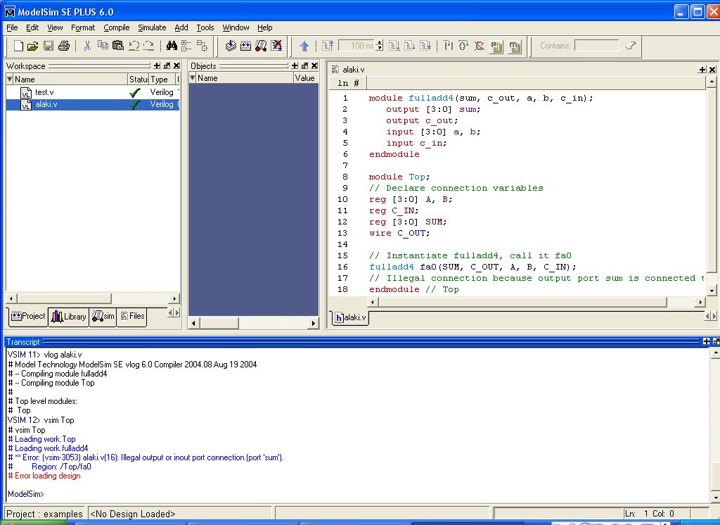
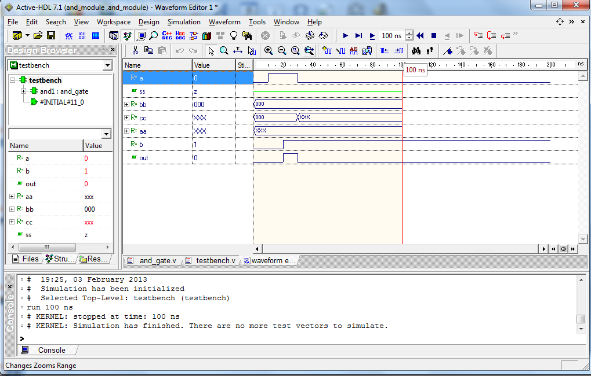
Simulator Tools
ModelSim
Mentor Company
ISIM
Xilinx
Active-HDL
Aldec Company
.... Many other simulations

Slide 40
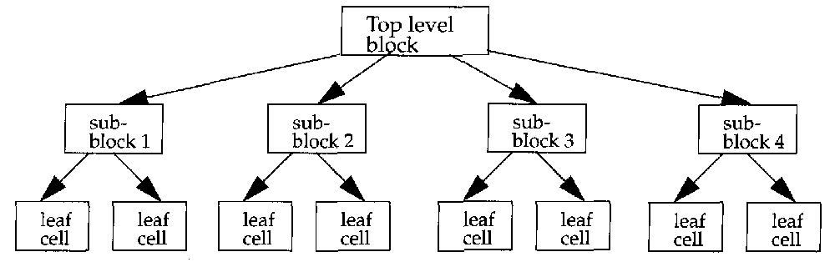
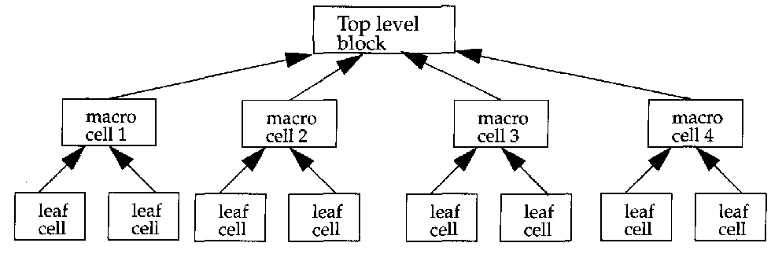
Hierarchical Design
Two Design Methodologies
Top – Down
Complete understanding of the system.
No coding can begin until a sufficient level of detail has been reached
Placing black boxes stubs instead real modules.
Increase the delay of testing the ultimate system until significant design is complete.
Bottom-Up
Emphasizes coding and early testing,
as soon as the first module has been specified.
Increases the risk of design (no clear idea of how the sub-modules link to each other.
Re-usability of code is one of the main benefits of the bottom-up approach
In practice we use a mixture of them.

